Slide 1





Prioritization Grid
Total =70/100
Pre-cooked food
^{High}
Outfit recommendation
Background translation
Value
Bus routing Application
Stance support
^{Low}
^{Low}
Feasibility
^{High}

Slide 2
Prioritization Grid - Analysis
4/5
Background translation app
highest value to users and relatively high level of feasibility
directly alleviates the problem of language barrier facing by foreigners when they come to China
foreigners would also have a gain of accessing to more content which is originally barriered by language issues
technology threshold of the app is relatively lower
^{High}
Value
^{Low}
^{Low}
Feasibility
^{High}

Slide 3

Our Product

Slide 4

Market segmentation and targeting
Target Segment
foreign tourists and expatriates in Mainland China
Problems and Characteristics
those with low level of proficiency in Chinese, they are facing language barrier when reading or using Chinese websites and software, including payment applications and mini-apps (WeChat, Taobao, etc.)
inadvertently miss some Chinese contents that maybe useful because of language barriers
Demand
need translation from Chinese in overcoming language barriers
access more diverse contents with Chinese easily
a more convenient translation method

Slide 5
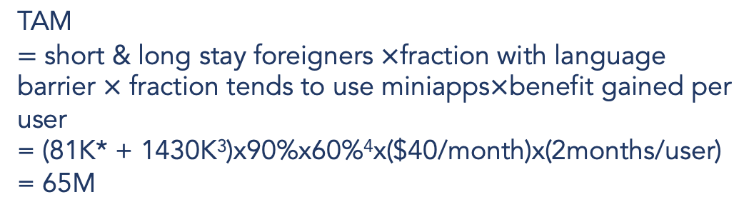
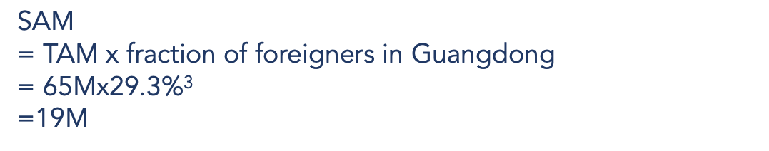
Market size
10/20
TAM
$65M
Is this for the whole China?
SAM
$19M
Could not find reference 3
SOM
$1.5M
SOM = SAM x fraction of obtainable
= 12M x 8%
= 1.5M
* Calculated by Little’s Law with references 1 and 2

Slide 6


Persona
Without our product
They try to ask help from staffs
However, they are not able to communicate…
Helplessly, they screenshot the menu page by page and upload them onto translation app
Mr. and Mrs. Chan
Going for sightseeing in China
Have access to the internet
Have their own VPN
Do not join tour-groups
They are ordering food in a restaurant
They opened the digital menu…
The wordings are badly translated without presenting the meaning exactly
They can only order according to the cuisine photos
They feel sad ☹

Slide 7
Pain points (what we saw in the persona)
17/20
Functional Jobs
Perform online administrative tasks such as ordering food in the mini programs in WeChat, Alipay, etc.
Want to get rid of the inconvenience caused by turning on and off VPN when switching between foreign translators and mainland paying applications.
^{Highest}
Emotional Jobs
Do not want to feel insecure and frustrated to seek help every time when they encounter a new mini program without translation
Importance
Social Jobs
Want to perform more independently by not reaching out for help from other staff or locals when they are reluctant / cannot speak foreign languages
^{Least}

Slide 8
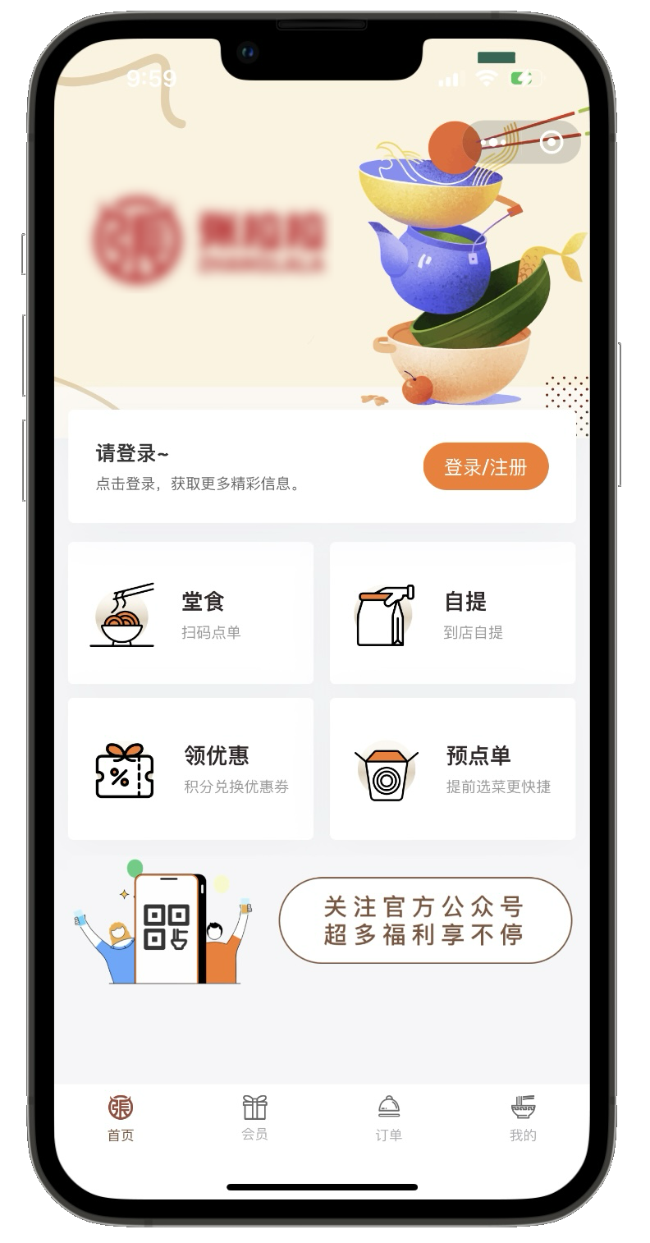
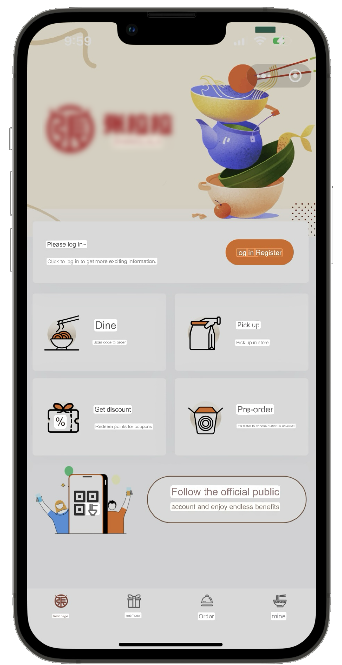
Solution
18/30
Switching from app to app
Background application
Switching on and off VPN
Develop in mainland
Feel frustrated when reaching out for help / cannot seek help
More accurate and localized translation according to various industries
Inconvenience
One-click translation within the selected adjustable frame until switched off

Slide 9
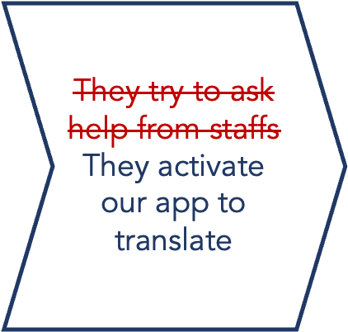

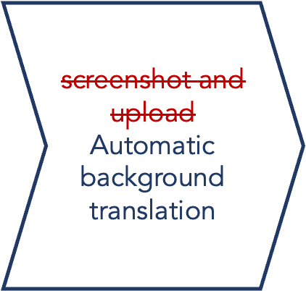

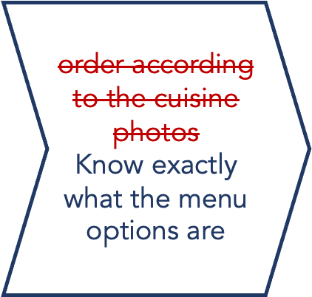

Persona
With our product
Mr. and Mrs. Chan
Going for sightseeing in China
Have access to the internet
Have their own VPN
Do not join tour-groups
They are ordering food in a restaurant
They opened the digital menu…

Slide 10
Competitor analysis
8/10
Direct competitors
Indirect competitors
Potential competitors
Product | CHanslate | Translate On Screen | Google Translate | Baidu Translate | (Companies)
Translation technology | Neural machine | Neural machine | Neural machine | Neural machine | Translation development
Translation quality | High, tuned for Chinese text | High | Medium for Chinese text | High, tuned for Chinese text | High, specified for their own company
Accessible in China | Yes | No | No | Yes | Yes, for Chinese companies
Optical character recognition | Yes | Yes | Yes | No | No
Optimized for mini-apps | Yes | Yes | No, need manual text copying, or screenshot | No, need manual text copying | Yes
Pricing | Weekly ($12) /monthly ($40) user plan | Free / weekly($19.9)/ monthly($48)/ Yearly($198) / one time purchase($388) | Free | Free | Free

Slide 11
Product
Comparative Advantages
Concerns
Solution
Most user-friendly in the market
May have privacy concerns from the users
Automatically delete translation data after 24 hours
Can expand to not only tourists’ use, but public’s daily use
Easy to be copied by the other companies
Can expand to out of China
Develop customer stickiness
Small market segmentation
Language model developed can be utilized in other industries

Slide 12


Business model
Weekly plan/
Monthly plan
(charge per use)
$12/week
$40/month
Free download
Advertisements

Slide 13
Appendix – references & attributions
1 https://www.nia.gov.cn/n741440/n741567/c1589194/content.html
2 https://www.ceicdata.com/en/china/tourism-shanghai/shanghai-visitor-average-length-of-stay-foreigner
3 https://www.gov.cn/xinwen/2021-05/11/content_5605792.htm
4 http://www.xinhuanet.com/english/2017-05/17/c_136292324.htm
5 pricing scheme inspired by iTranslate
https://www.flaticon.com/free-icons/salad
Salad icons created by Freepik
https://www.flaticon.com/free-icons/closet
Closet icons created by Freepik
https://www.flaticon.com/free-icons/bus
Bus icons created by Freepik
https://www.flaticon.com/free-icons/translate
Translate icons created by Freepik
https://www.flaticon.com/free-icons/handrail
Handrail icons created by Nikita Golubev
https://www.flaticon.com/free-icons/tourist
Tourist icons created by Eucalyp
Mini program sample: 張拉拉牛肉麵
https://www.flaticon.com/free-icons/misunderstanding
Misunderstanding icons created by bsd

